Slide 1
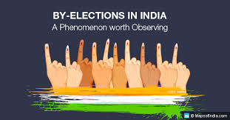
2014 lok sabha election results
Exploratory Data Analysis

Slide 2
BACKGROUD
The elections were conducted in 9 phases from 7 April 2014 to
12 May 2014 by the Election Commission of India. The results of
Election were declared on 16 May 2014. The Bharatiya Janata
Party (of the NDA) achieved an absolute majority with 282 seats
out of 543, 166 more than previous 15th Lok Sabha

Slide 3
Data Loading and Description
The dataset consists of information about 2014 Lok Sabha Election result. This contains constituency wise data including state name, Polling center name, Candidates name, Sex of Candidate, Age, Category, Name of Party, Secured Votes, Total electors.
The dataset comprises of 8355 records for all seats with below . Below is a table showing names of all the columns and their description.
Column Name | Description
State Name | Name of State
PC Name | Polling Center Name
Candidate Name | Name of Candidate
Sex | Sex of Candidate
Age | Age of Candidate
Category | Category of Candidate
Party Name | Name of Election
Votes General | Secured Votes of General
Votes Postal | Secured Votes of Postal
Total Electors | Total Electors
Result | Result of Election of Polling Center

Slide 4
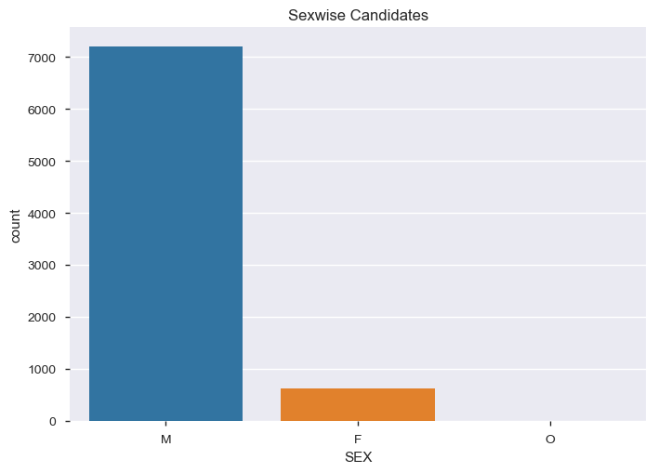
Candidate gender wise Graph
.
SEX F 630
M 7208
O 6

Slide 5
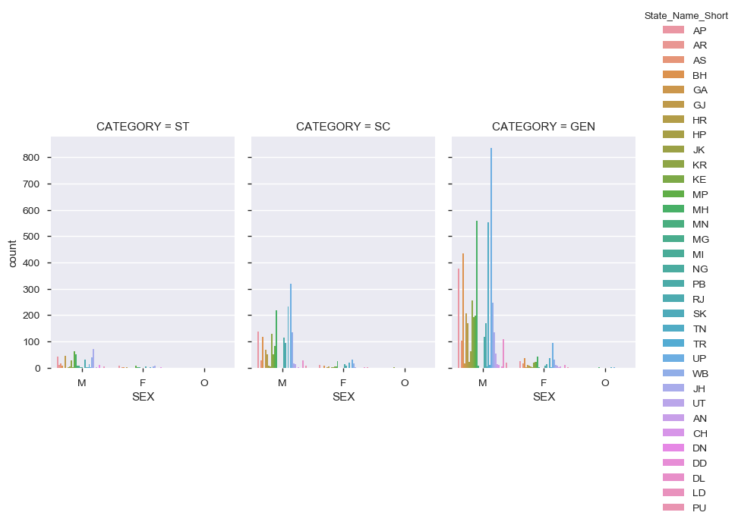
Candidate categorywise & statewise Graph
.

Slide 6
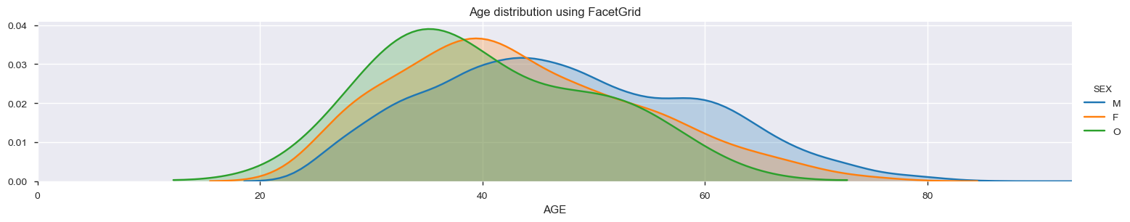
Candidate ‘s age dISTRIBUTION
.
Majority of Age of Male candidates were between 25 to 75
Majority of Age of Female candidates were between 25 to 55
Majority of Age of Other candidates were between 30 to 55

Slide 7
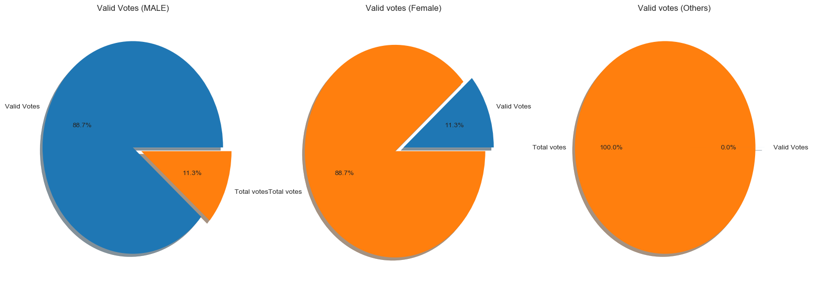
Candidate ‘s genderwise valid votes ( evm & postal )
86.7% valid votes are given to Male candidates
11.3% valid votes are given to Female candidates
Almost 0.0% valid votes are given to Others candidates

Slide 8
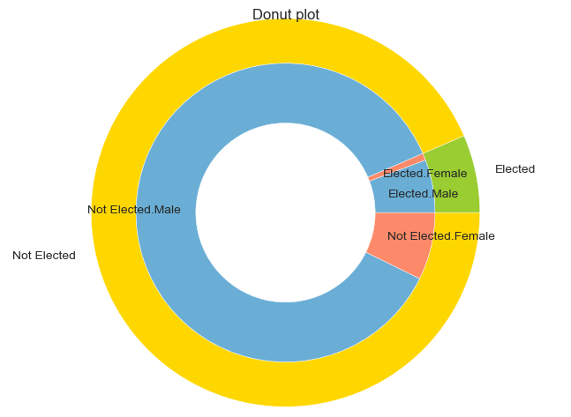
elected & not elected candidates genderwise

Slide 9
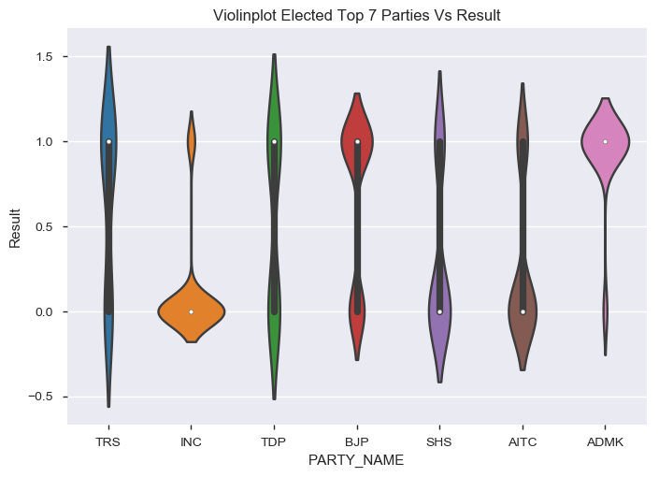
Top 7 parties elected seats

